Slide 1
Capstone Engagement
Assessment, Analysis, and Hardening of a Vulnerable System
By: Yaimara Narito
November 8th, 2021

Slide 2
Table of Contents
This document contains the following sections:
01
Network Topology
02
Red Team: Security Assessment
03
Blue Team: Log Analysis and Attack Characterization
Hardening: Proposed Alarms and Mitigation Strategies
04

Slide 3
Network Topology
‹#›

Slide 4
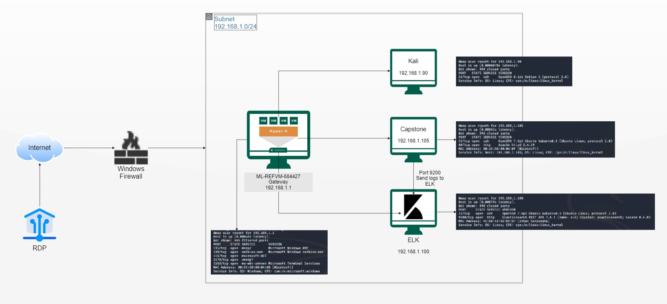
Network Topology
[Insert Here]
Use draw.io to create a diagram of the network.
Add your diagram to this slide and fill out the data in the sidebar.
Network
IP Range: 192.168.1.0/24
Netmask: 255.255.255.0
Gateway: 192.168.1.1
Machines
IPv4: 192.168.1.1
OS: Window
Hostname:
ML-REFVM-684427
IPv4: 192.168.1.90
OS: Linux
Hostname: Kali
IPv4: 192.168.1.100
OS: Linux
Hostname: ELK
IPv4: 192.168.1.105
OS: Linux
Hostname: Capstone

Slide 5

Red Team
Security Assessment
‹#›

Slide 6
Recon: Describing the Target
Nmap identified the following hosts on the network:
Hostname | IP Address | Role on Network
ML-REFVM-684427 | 192.168.1.1 | Gateway with Hyper-V (NATSwitch)
Kali | 192.168.1.90 | Penetration Testing System (Attacker’s VM)
ELK | 192.168.1.100 | SIEM System (receives logs from the Capstone VM)
Capstone | 192.168.1.105 | Web Server (Victim’s Machine)

Slide 7
Vulnerability Assessment
The assessment uncovered the following critical vulnerabilities in the target:
Vulnerability | Description | Impact
Sensitive Data Exposure: CWE-200: Exposure of Sensitive Information to an Unauthorized Actor | The product exposes sensitive information to an actor that is not explicitly authorized to have access to that information. | According to CWE the common impact of sensitive data exposure is read application data
Brute Force Vulnerability: CWE-307: Improper Restriction of Excessive Authentication Attempts | The software does not implement sufficient measures to prevent multiple failed authentication attempts within in a short time frame, making it more susceptible to brute force attacks. | According to CWE the common impact of brute force vulnerability is bypass protection mechanism.
Remote Code Injection: CWE-94 - Improper Control of Generation of Code ('Code Injection') | The software constructs all or part of a code segment using externally-influenced input from an upstream component, but it does not neutralize or incorrectly neutralizes special elements that could modify the syntax or behavior of the intended code segment. | According to CWE the common impacts of remote code injection include bypass protection mechanism, gain privileges or assume identity, execute unauthorized code or commands, and hide activities.

Slide 8
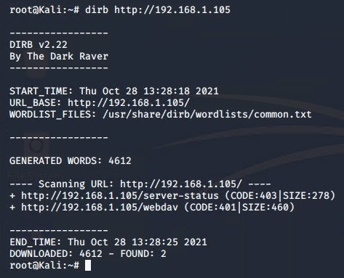
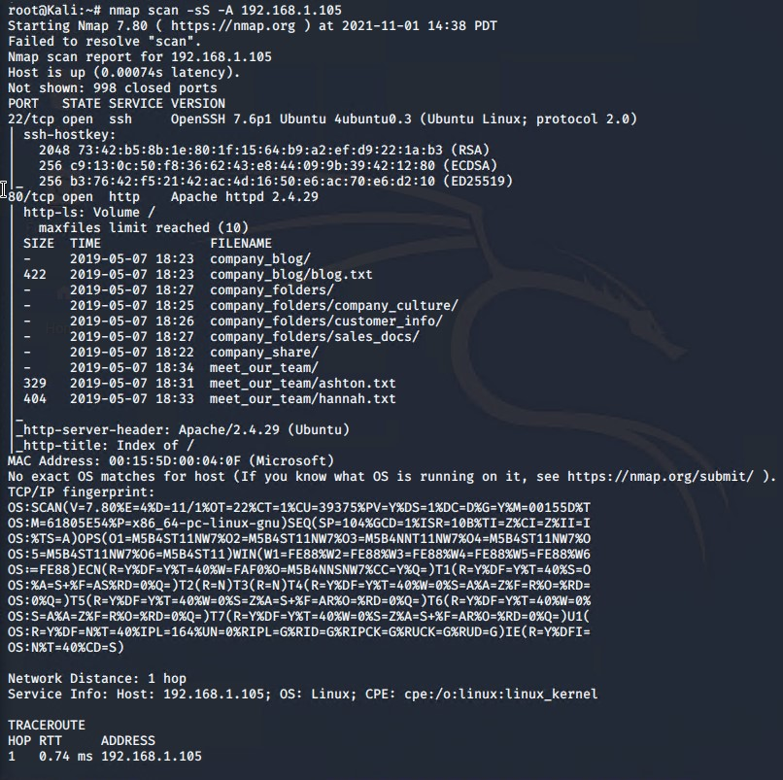
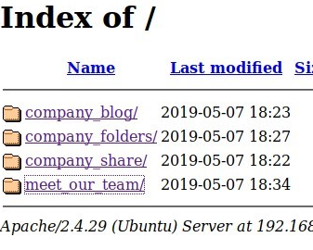
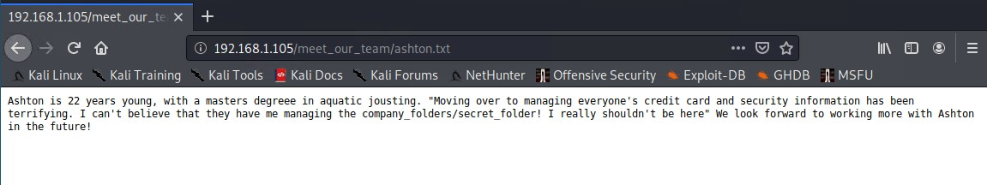
Exploitation: Sensitive Data Exposure (CWE-200)
01
02
03
Tools & Processes
nmap for scanning the network.
dirb for scanning the web.
Firefox for browsing the mapped URLs.
Achievements
Exposed Server’s URLs.
Exposed files including the /company_folders/secret_folder
Exposed Ashton as the user managing the secret_folder.
Exploit Outcome

Slide 9
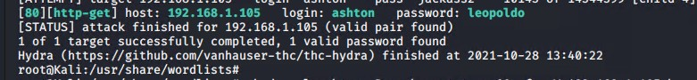
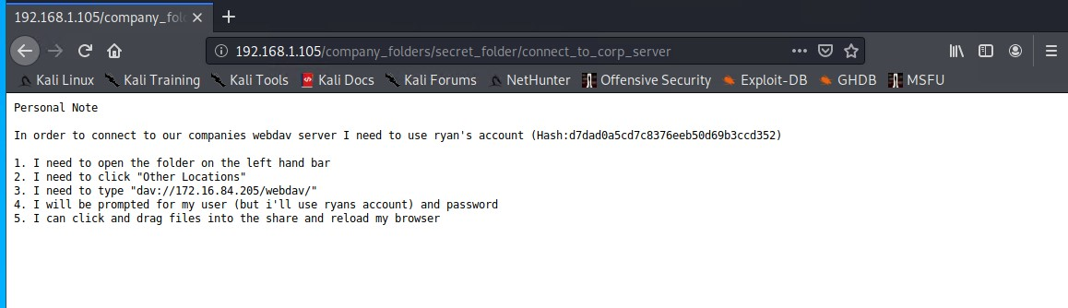
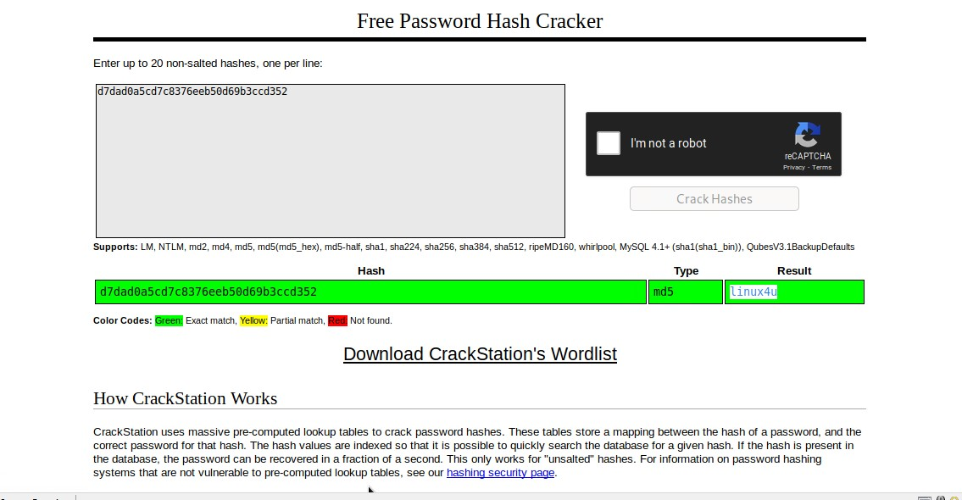
Exploitation: Brute Force Vulnerability (CWE-307)
01
02
03
Tools & Processes
Hydra tool(parallelized login cracker).
Firefox to login into the secret_folder.
Cracking Station to decrypt Ryan’s password hash.
Achievements
Ashton’s login credentials revealed.
Access to the /company_folders/secret_folder gained.
Instructions to access the WebDAV server revealed.
Exposure of Ryan’s hashed credentials.
Exploit Outcome

Slide 10
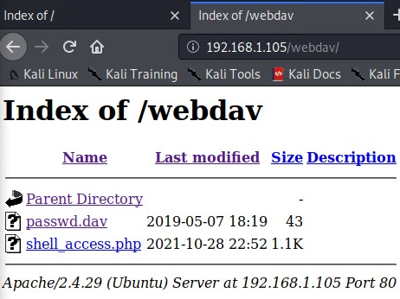
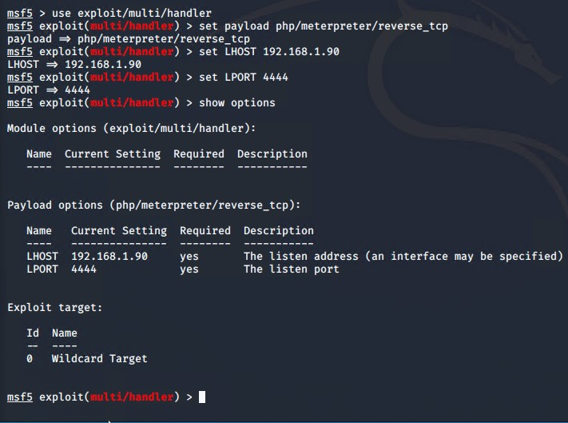
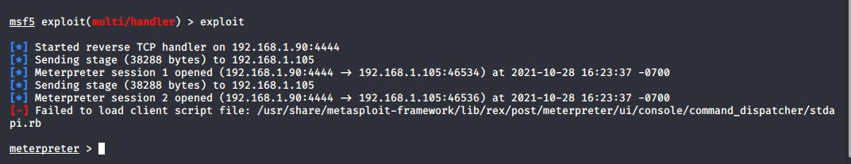
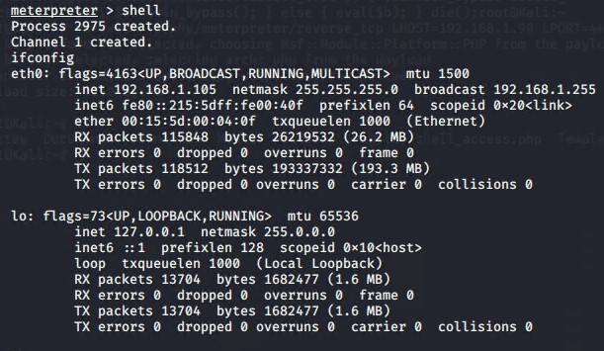
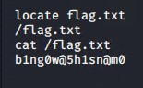
Exploitation: Remote Code Injection (CWE-94)
01
02
03
Tools & Processes
msfvenom to create the reverse shell .php file.
msfconsole exploit/multi/handler to exploit php/meterpreter/reverse_tcp payload.
File manager to upload the access_shell.php malicious file to the server.
meterpreter session to explore the Capsone server.
Achievements
Successfully uploaded the access_shell.php payload to the WebDav server.
Successfully established connection with the reverse shell on the victim’s machine, Capstone Server.
Found the target file, Flag.txt in the Capstone Server.
Exploit Outcome

Slide 11

Blue Team
Log Analysis and Attack Characterization
‹#›

Slide 12
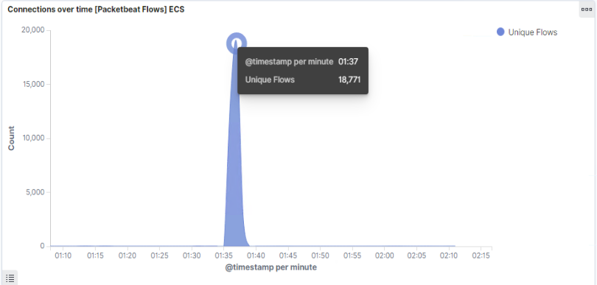
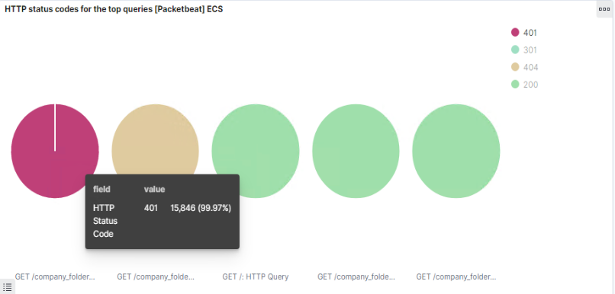
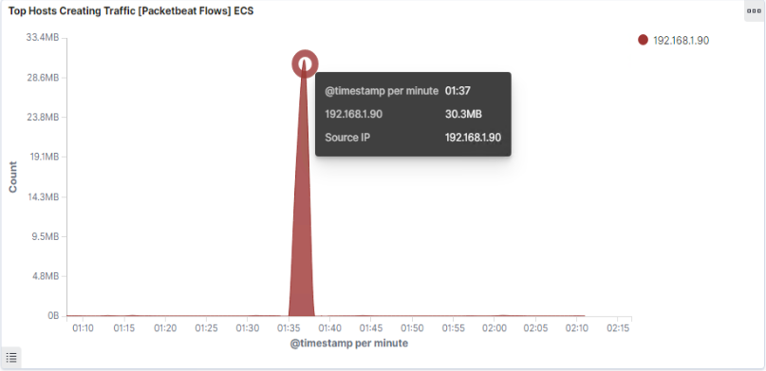
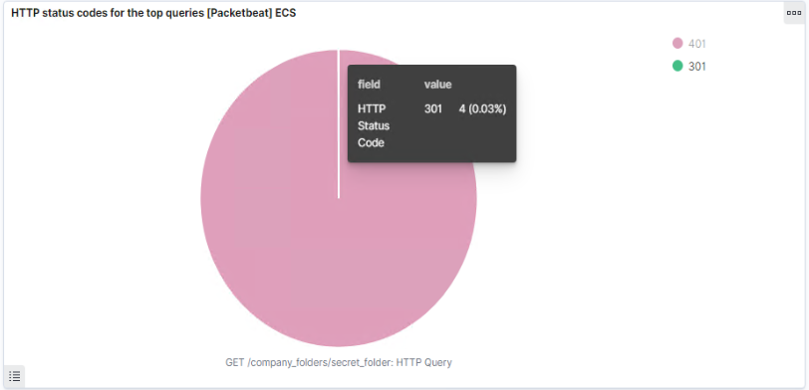

Analysis: Identifying the Port Scan
The port scan occurred on October 28th, 2021 @ 01:37 am.
There were 18,771 packets sent from 192.168.1.90 during the attack.
The high volume of traffic during such a short time resulting in 401 and 404 error codes indicates that there is a port scanning occurring during that period of time.

Slide 13
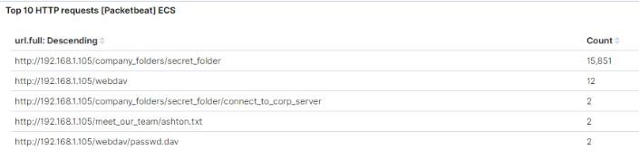
Analysis: Finding the Request for the Hidden Directory
Starting with the attack on October 28th, 2021 @ 01:37 hrs, 18,771 file requests were made, from which 15,851 were made to the hidden /company_folders/secret_folder directory.
After successfully acquiring login credentials to the hidden folder, it is visible that the hidden file: http://192.168.1.105/company_folders/secret_folder/connect_to_corp_server was accessed @ 01:44 hrs. The file contained sensitive information such as instructions to connect to the web server and the exposure of the hash for Ryan’s password.
Other files accessed include:
http://192.168.1.105/webdav
http://192.168.1.105/webdav/passwd,dav
http://192.168.1.105/meet_our_team?ashton.txt

Slide 14
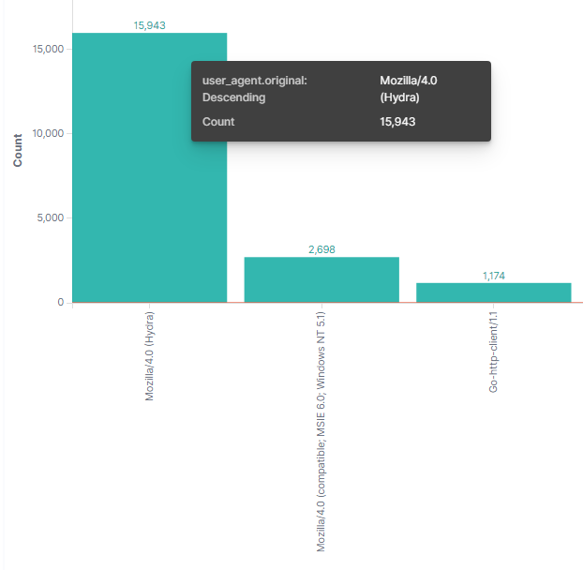
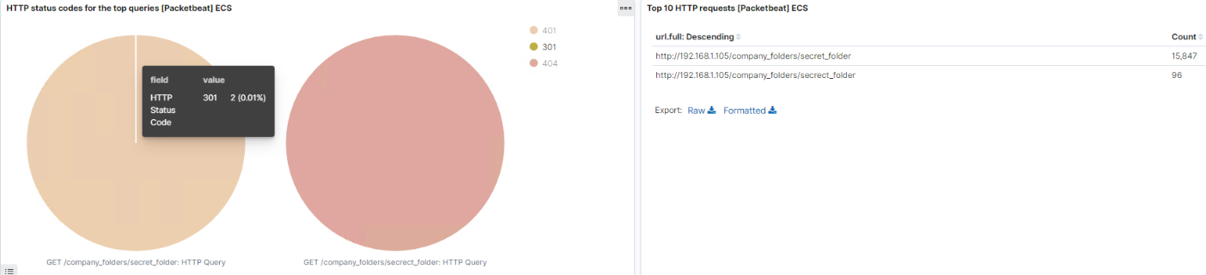
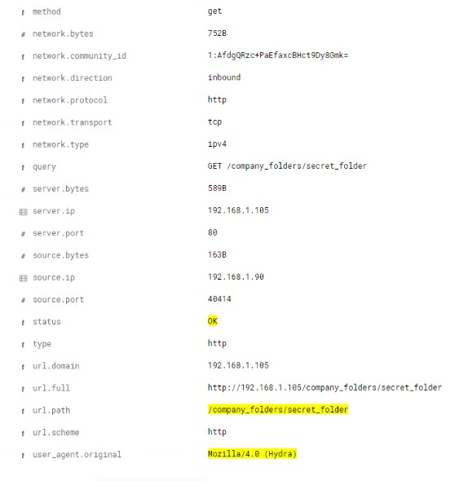
Analysis: Uncovering the Brute Force Attack
During the brute force attack, hydra made a total of 15,943 requests.
In this screen it is evident that numerous requests were made to the password protected /company_folders/secret_folder directory returning several 401 (15,845 requests) and 404 (96 requests) errors for a total of 15,941 failed requests.
In addition, out of a total of 15,943 requests, only 2 successful requests were made to the file inside the directory. This behavior is an indication of a brute force attack.

Slide 15
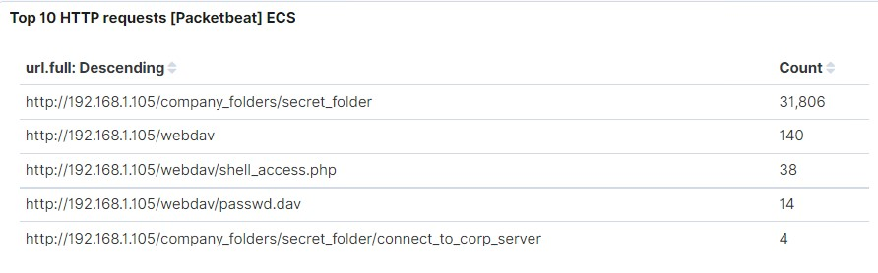
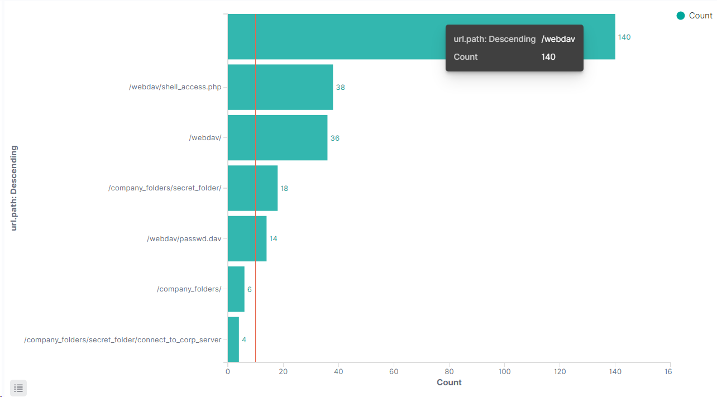
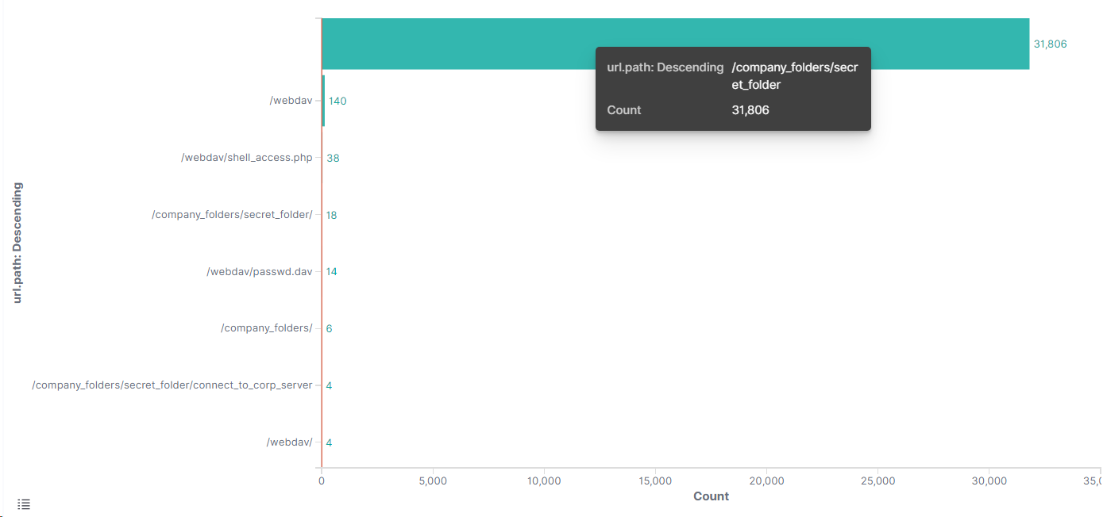
Analysis: Finding the WebDAV Connection
After the attack, the /company_folders/secret_folder directory was requested several more times. Also, the confidential file, /company_folders/secret_folder/connect_to_corp_server, within this directory was requested 4 times.
The WebDav server was requested 140 times and the shell_access.php, the payload file, was requested 38 times. The first successful request to the file was made @22:52 hrs.
Here is visible that the WebDav server was accessed and that the breach took place successfully.

Slide 16
Blue Team
Proposed Alarms and Mitigation Strategies
‹#›

Slide 17
Mitigation: Blocking the Port Scan
Alarm to detect future port scans:
Alert when excessive requests for numerous ports per second are made from the same IP address within a set timeframe.
Threshold to activate this alarm:
The alarm will flag a behavior as a port scan attack and activate when more than 10 different ports are requested from the same IP address within 0.005 seconds or 5000 microseconds.
Future port scans can be mitigated by taking several precautions, including:
Configure local firewall to block incoming requests from unknown hosts.
Disable port forwarding on the routers.
Employ TCP wrappers to allow/deny access based on IP addresses and domain names.
Close unnecessary ports and services.

Slide 18
Mitigation: Finding the Request for the Hidden Directory
Alarm to detect future unauthorized access:
Alert when a non-whitelisted IP address attempts to connect to the server and access restricted files.
Threshold to activate this alarm:
The alert will trigger only if it detects incoming traffic of an unauthorized (not whitelisted) IP address.
To block unwanted access to restricted files, numerous steps can be taken:
Create an IP address whitelist.
Restrict access to confidential files to a specific user.
Remove confidential files from the server.
Encrypt data at rest.
Employ a stronger password policy.

Slide 19
Mitigation: Preventing Brute Force Attacks
Alarm to detect future brute force attacks:
Set up an alert that detects a sharp increase in login attempts over a certain period of time.
In addition, an alert needs to be set up that triggers when there is an increase in 401 errors in as specific period of time.
Alert when user_agent.original value includes Hydra
Threshold to activate this alarm:
The alert will trigger when it detects more than 15 requests per second.
The alert will fire when it detects more than fifteen 401 errors per second.
The alert will notify when user_agent.original value includes Hydra in the name.
To prevent future brute force attacks several mitigation techniques can be implemented:
Monitor systems for vulnerabilities.
Strengthen the human firewall.
Unique/complex password/passphrases requirements.
Make the root user inaccessible via SSH by editing the sshd_config file.
Store only SOLTED password hashes on servers.
CAPTCHA tool
Adopt passwordless authentication.

Slide 20
Mitigation: Detecting the WebDAV Connection
Alarm to detect future connections to WebDav:
Alert when requests are made to access the WebDav from a non-whitelisted IP address.
Threshold to activate this alarm:
All requests to access files within WebDav from a non-whitelisted IP address will set off the alert.
To prevent unwanted access to WebDav:
Whitelist IP addresses.
Set strict permissions and privileges.
Diligently monitor server logs.
Turn off unneeded functions.
Change defaults.
Do not keep sensitive information stored in WebDav.
Encrypt data at rest and in transit.
Implement separation of Privilege.

Slide 21
Mitigation: Identifying Reverse Shell Uploads
Alarm to identify reverse shell uploads:
Alarm that fires when it detects POST requests of unauthorized files, i.e., .php, to the server.
Threshold to activate this alarm:
Notify when any user attempts to upload prohibited files.
To defend against reverse shell uploads:
Define valid file types allowed to upload.
Do not allow .php files to be hosted on WebDav.
Restrict writing permissions.
Input validation.
Require authentication to upload files.

Slide 22
References
Christopher, R. (2001, October 5). Port scanning techniques and the defense against them. SANS. https://sansorg.egnyte.com/dl/hEbx2UI5Hu
CWE - CWE-200: Exposure of sensitive information to an unauthorized actor (4.6). (2021, October 26). CWE - Common Weakness Enumeration.
https://cwe.mitre.org/data/definitions/200.html
CWE - CWE-307: Improper restriction of excessive authentication attempts (4.4). (2021, March 15). CWE - Common Weakness Enumeration.
https://cwe.mitre.org/data/definitions/307.html
CWE - CWE-434: Unrestricted upload of file with dangerous type (4.5). (2021, July 20). CWE - Common Weakness Enumeration.
https://cwe.mitre.org/data/definitions/434.html
CWE - CWE-94: Improper control of generation of code ('code injection') (4.6). (2021, October 26). CWE - Common Weakness Enumeration.
https://cwe.mitre.org/data/definitions/94.html
Port-scan. (n.d.). Juniper Networks – Global Leader in AI Networking, Cloud, and Connected Security Solutions.
https://www.juniper.net/documentation/us/en/software/junos/denial-of-service/topics/ref/statement/security-edit-port-scan.html

